Slide 1

University database
Zhandos Zhanatov

Slide 2

Gantt chart

Slide 3

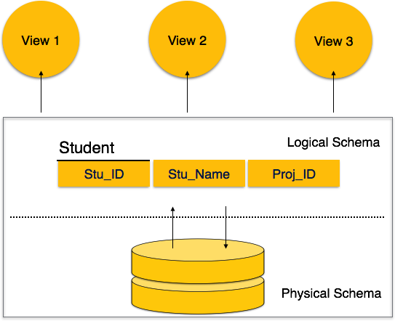
introduction
DBMS software primarily functions as an interface between the end user and the database, simultaneously managing the data, the database engine, and the database schema in order to facilitate the organization and manipulation of data.

Slide 4

The aim
The main purpose of this project was to create DBMS for university with included information about students, teachers and etc.

Slide 5
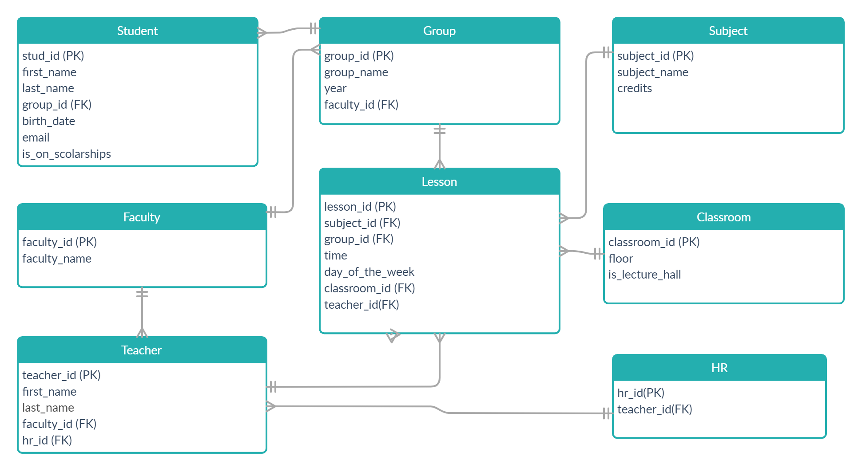
ER diagram

Slide 6






tables

Slide 7
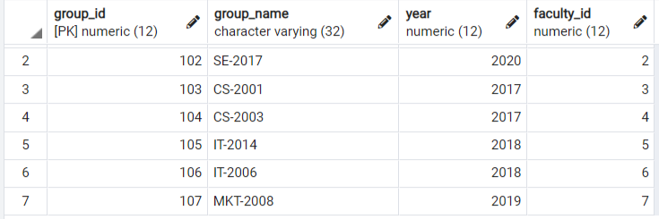

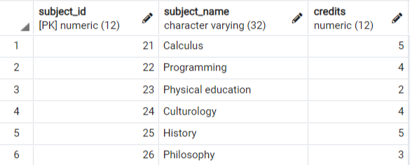


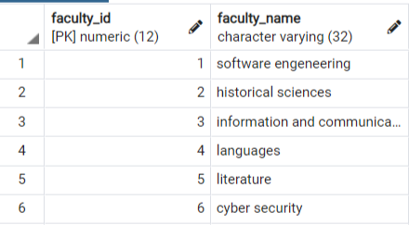
Inserting some data

Slide 8

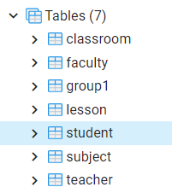
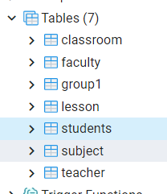

Inserting and alter statements

Slide 9
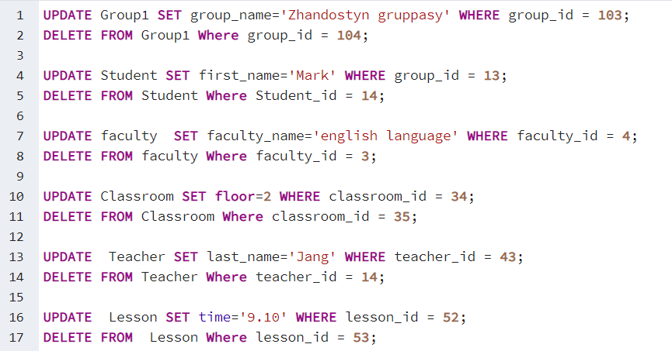

Update and delete queries

Slide 10

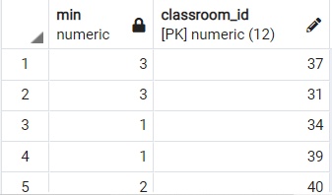
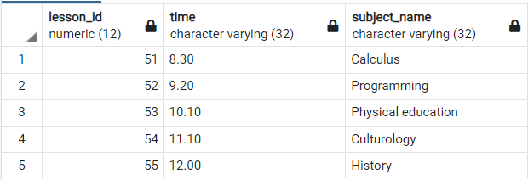



queries

Slide 11


